Slide 1
Fingerprint Voting System
Ronit Prasad
Concordia University Chicago: Computer Science – Software Engineering
Dr. Selvanayaki KS
November 11th, 2020

Slide 2
Project Scope and the Objective:
The project objective is to develop a project that can recognize users based on their fingerprint patterns for voting. Since finger print authentication is unique for each person, the system can easily figure out who you are naturally. The person who receives the fingerprints can be known as the "Admin" or "System-Manager." The admin can add all the names and photos of the candidate based on who they picked to vote for the election. The admin has the ability log into the system and also give users their unique ID and password, so you have the ability to personally vote and check your status. The objective of this system is probably to make information-giving a bit less on the client side. The clients won't have to give as much information as usual. They don't have to put their address in, phone number, age, birthday, SSN, and information. They simply just have a unique username/password and their own unique finger-print.

Slide 3
Project Management Plan
The project management plan would include a lot of information about the general content of the project at hand (e.g., Scope, Strategy, Project Issues, Approvals, Communication, and Constraints).
Target:
Constraints:
Time - how long the government actually allows us to have information of each individual person, how long it takes for people to sign up and the persistence of doing this, and then gathering all of that information of the people who’ve signed up in the database + government and maintaining it.
Method of Advocacy:
Communication - I would say mail, online, email, and any other form of communication to be able to promote finger-print voting by our next election or in the near future.

Slide 4
Elicitation Analysis
Elicitation just means collecting intelligence information from people and the client-side of that project based on the number of people, and we can do this in two ways:
First way:
Collecting information from people is rather easy, if we have a connection with the government database, and they allow us to have information on each person based on their fingerprint – we then have information.
Second way:
Another way would be, just have regular government site polls to be able to see public opinion and based on that we can be more efficient.

Slide 5
Risk Management
Risk management means to analyze the problems and the potential problems that can arise from a specific task. In my case, the specific tasks would be: voting, voting process, information, and the information process.
Risks / Potential Risks:
- Security risk in the database.
- Loss of information through manipulation.
[pulling out information and possibly information being wiped?]
- Interaction between people / Health hygiene during actually voting in local voting areas.

Slide 6
Requirement Engineering Process
Personally, I would document REP (Requirement Engineering Process) to be drafted in four sections: Elicitation, Validation, Specification, and some sort of Intercession.
Sections:
Elicitation: This would mean how the engineering team talks with the stakeholders and come up with requirements. Whether, something can be usable, readable, deployable, etc.
Validation: Whether our process, design, or system meets the requirements of the stakeholders. In my case, an example would be, whether the information process achieves everything that both the engineering team wants and the stakeholders.
Specification: The specifics, processes, and how the processes of the stakeholders interrelate.
Intercession: The conversation between the stakeholder and the engineering team and the different disagreements that form. Some disagreements could be security problems, how the system interacts with us, or the information process.

Slide 7
Requirement Specification
The database information can only be accessed by admins or people who handle the information manipulation.
The user should be able to pick a party/person to vote and not be able to vote again, since 1 vote = 1 person.
The information process should be through a set of trials (verification process). If the voter passes the trial, then that person is eligible to be able to vote once and once only. Otherwise, they will need to prove that their information is real and not fake.

Slide 8
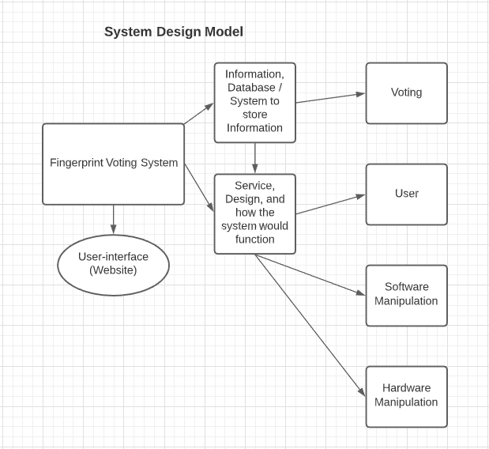
System Design + SDM
System Design is the process of designing the elements of a system such as the architecture, modules, components, and different interfaces go through that system.
In my case, it would just be the different processes and activities that I would take for fingerprint voting.

Slide 9
Analysis (Description)
The voter scans their fingerprint and then all the information gets pulled through our database.
If the information is false, then we ask them to go through a set of trials for information verification.
After login, the user will be verified through the database for duplicate information, and then only after that’s cleared he/she’s vote will be counted as one vote.
If the information is a duplicate then we search for any remnant where that person voted multiple times and then clear it as one vote only.
We then tie up all the votes from everyone who’s voted (Iff the votes are cleared to be one vote and one person is associated with one vote).

Slide 10
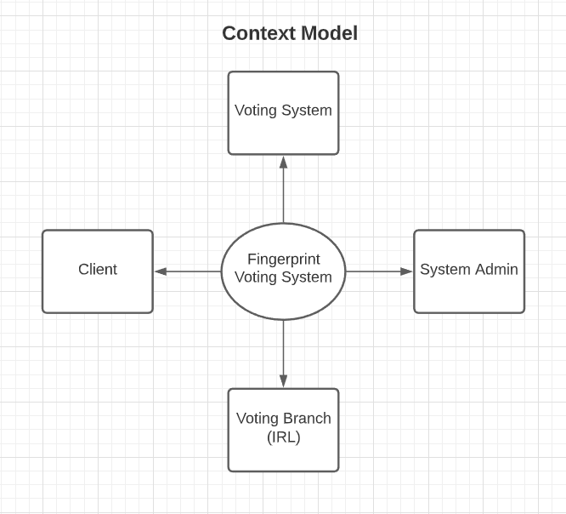
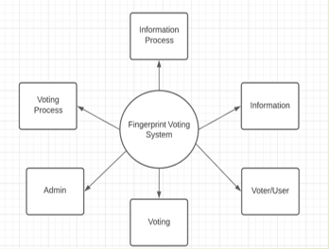
Context Model

Slide 11
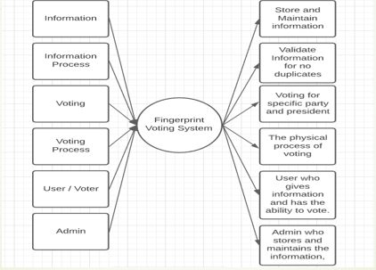
Level 1 Data Flow Diagram

Slide 12
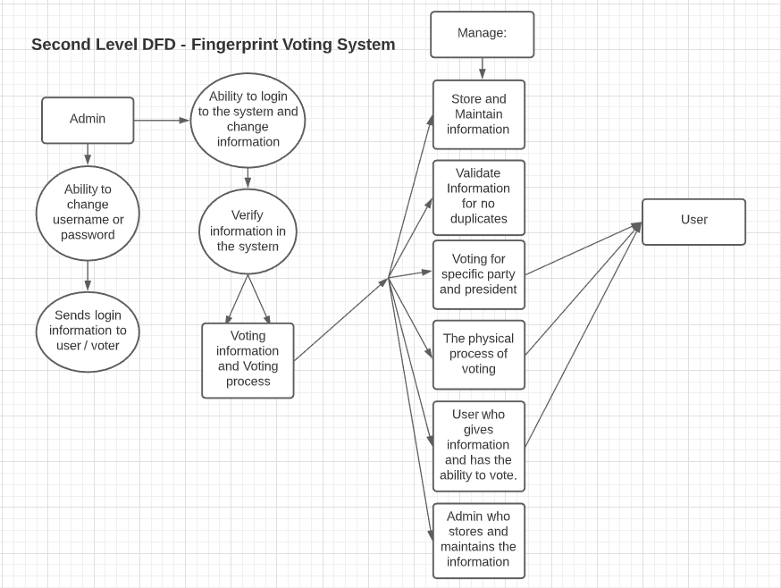
Level 2 Data Flow Diagram

Slide 13
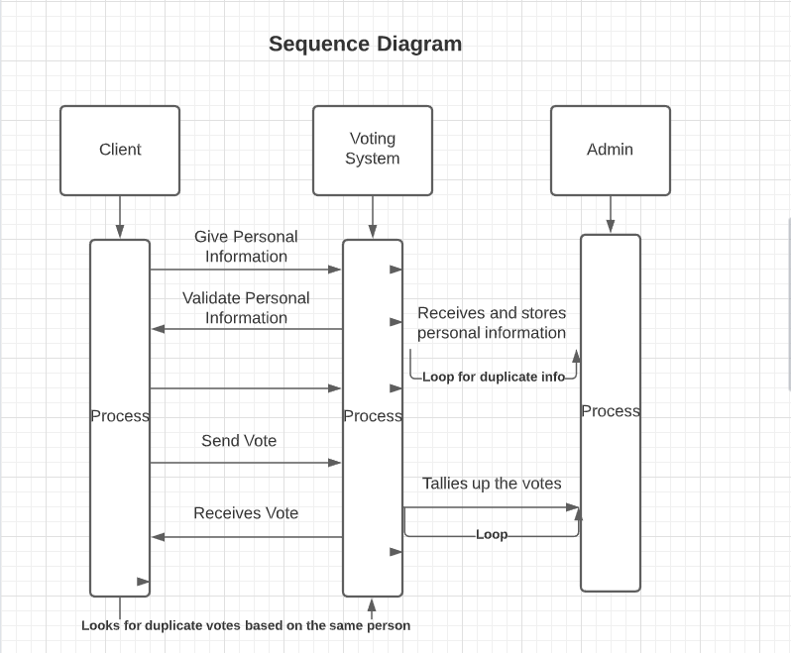
Sequence Diagram

Slide 14
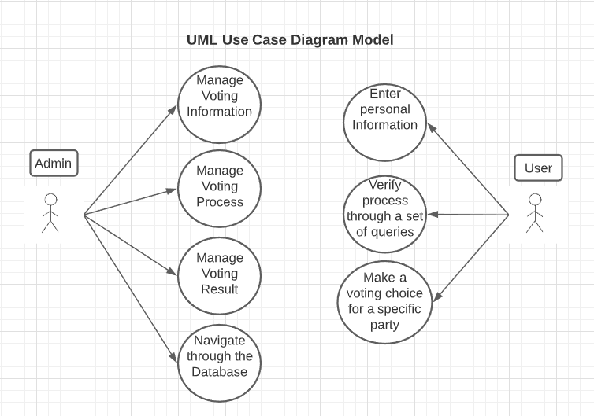
Use Case Diagram

Slide 15
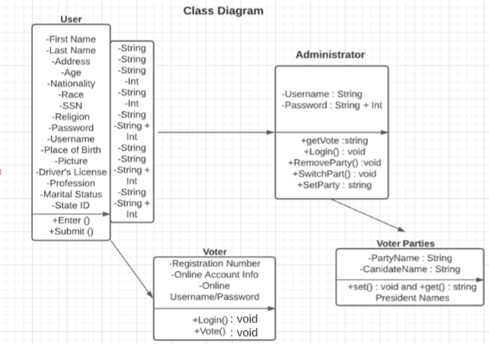
Class Diagram

Slide 16
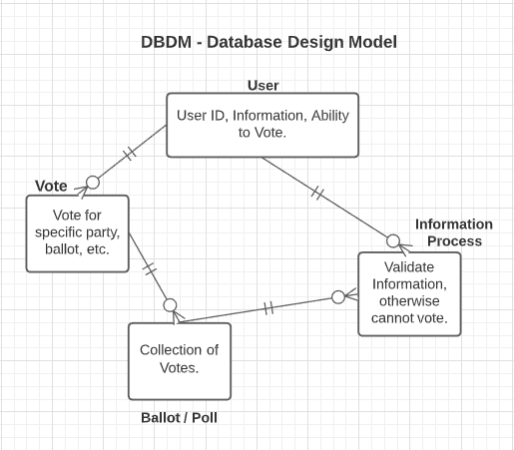
Database Design + DBDM
Database Design is how data is organized, stored, and how data elements are correlated to each other. Mostly all DBDM show how they all correlate with each and affect each other.
In my case, the user cannot vote without giving information, but the information has to be processed, and therefore the poll cannot happen and the votes cannot be tallied if we don’t have unique voters.

Slide 17
Database Design Data Types
User – The user would be a string and the user would vote for a specific party, which would be a (string) [letters only / (lowercase/capital letters)].
Vote – Votes would in the form of a number, so it would be an (int).
We would validate the votes based on the person’s information and whether it’s not a duplicate.
Ballot – The collection of votes would be as an (int).
Validate Information – We would check if the person hasn’t voted twice and check if the string matches our constraint.

Slide 18
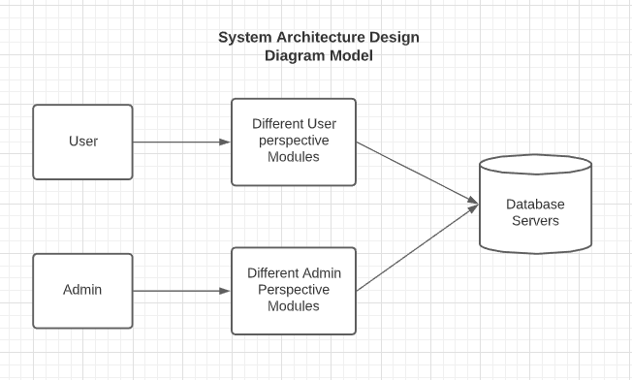
System Architect Design

Slide 19
Test Cases
Test Case 1: Voting for president / nominee
Doesn’t Work: Pres9ent Tr3mp
Works: President Biden
[Should only have Letters (Lowercase/Uppercase Letters)]
Test Case 2: User Name
Doesn’t Work: Tes3tUsername3
Works: TestUser
[Username can only have Lowercase/Uppercase Letters, not numbers as well]
Test Case 3: Password
Doesn’t Work: G3%myPassword321
Works: GuessMyPassword123
[Passwords can only have Letters and Numbers only]

Slide 20
Implementation
Coding Standards:
Proper declaration of information (public/private), global, local, and other constant variables.
Proper header and functions for information – I/O.
Syntax Manipulation (indentation, spacing, and proper code etiquette).
Debugging. (i.e., Exception Handling).
Tracking of modifications. (who does what and why)
Testcases (randomly generated or manually).
Execution:
I would probably execute step-by-step and learn from each execution and what goes wrong, so that next time that won’t happen.

Slide 21
Conclusion
Incorporating Software Engineering principles in this application is really vital and without those principles I highly doubt this would even work. However, this just shows that Software Engineering plays a major part in any software or application in the modern-world.

